Slide 1
Decision Trees

Slide 2
Reading Assignment
Chapter 8 of the Introduction to Statistical Learning By Gareth James, et all

Slide 3
Tree based methods
Let’s start with an example:
Let's assume we want to play badminton on a particular day — say Saturday — how will you decide whether to play or not. Let's say you go out and check if it's hot or cold, check the speed of the wind and humidity, how the weather is, i.e. is it sunny, cloudy, or rainy. You take all these factors into account to decide if you want to play or not.

Slide 4
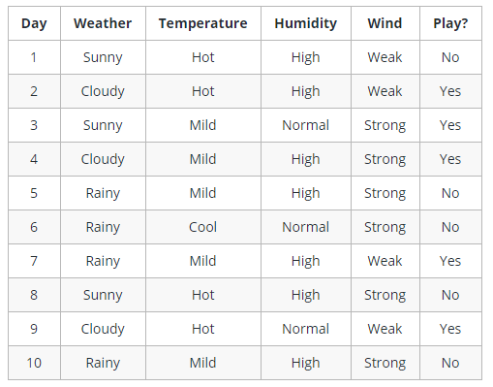
Tree based methods
Observation for last 10 days

Slide 5
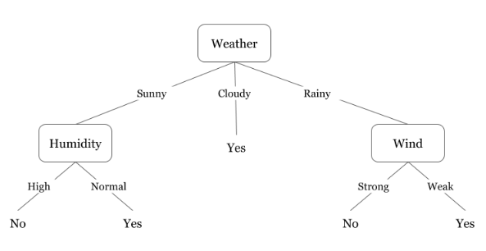
Tree based methods
Now if you want to decide whether to play or not, an intuitive way to decide would be through decision tree

Slide 6
Tree based methods
In this tree we have:
Nodes
Split for the value of a certain attribute
Edges
Outcome of a split to next node

Slide 7
Tree based methods
In this tree we have:
Root
The node that performs the first split
Leaves
Terminal nodes that predict the outcome

Slide 8
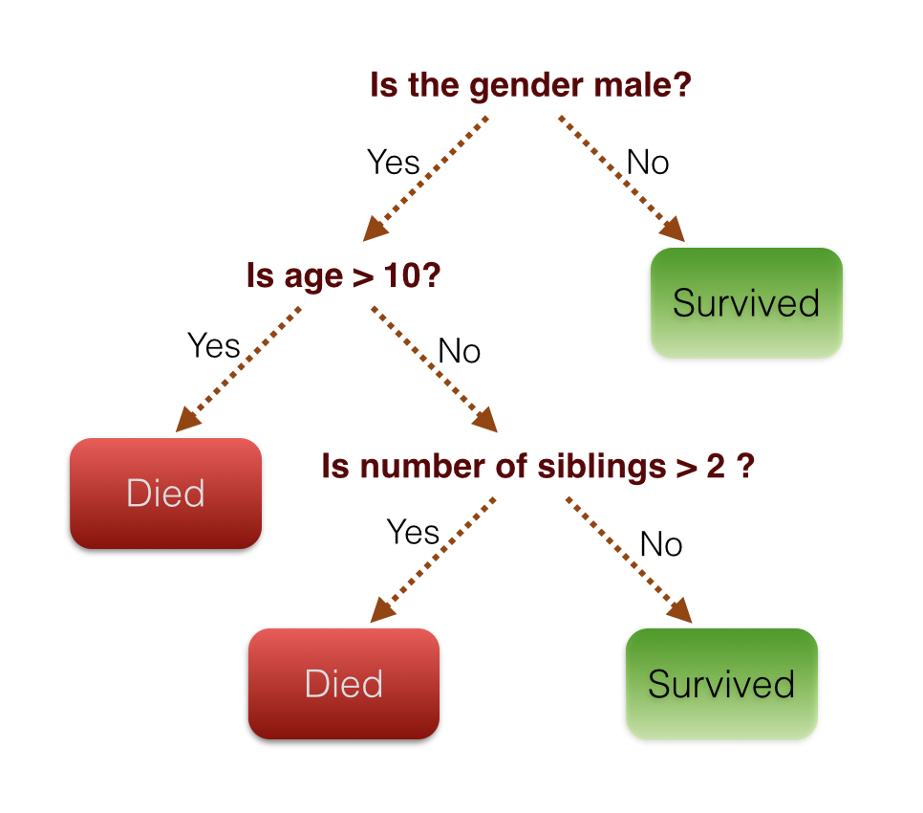
Tree based methods
Another example using titanic dataset

Slide 9
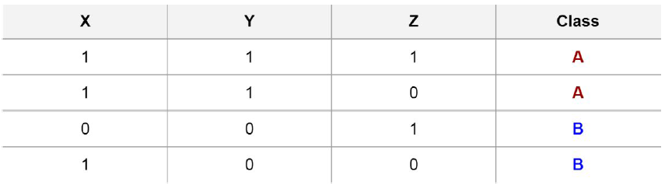
Intuition Behind Splits
Imaginary dataset with 3 features (X,Y and Z) and 2 possible classes A and B

Slide 10
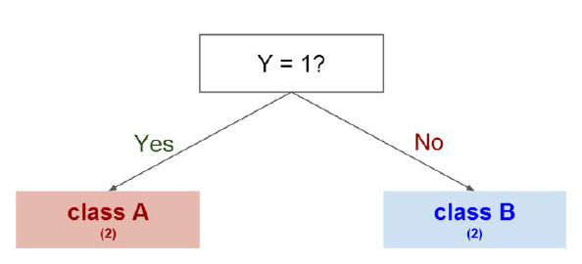
Intuition Behind Splits
Splitting on Y gives us a clear separation between classes

Slide 11
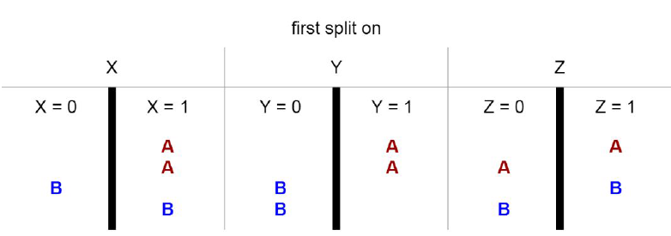
Intuition Behind Splits
We could have also tried splitting on other features first

Slide 12
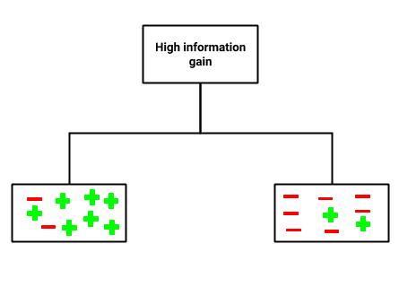
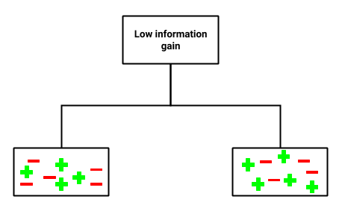
Intuition Behind Splits
Entropy and Information Gain are the mathematical methods of choosing the best split.
Information gain is a statistical property that measures how well a given attribute separates the training examples according to their target classification

Slide 13
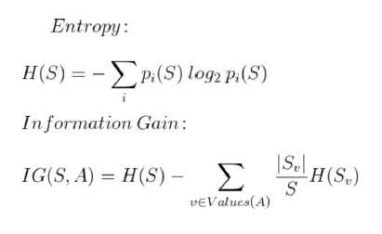
Intuition Behind Splits
To define information gain precisely, we need to define a measure commonly used in information theory called entropy that measures the level of impurity in a group of examples.

Slide 14
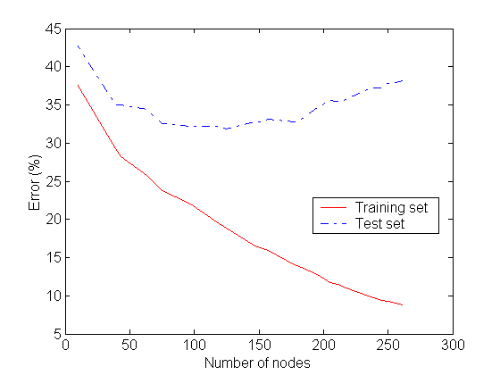
Notes:
As number of nodes increases the chances of overfitting increases in decision tree algorithm
Overfitting

Slide 15
Notes:
Classification and Regression Trees or CART for short is a term introduced by Leo Breiman to refer to Decision Tree algorithms that can be used for classification or regression predictive modeling problems
CART is a modern term for Decision Tree
R programming uses CART name
In Regression Tree, the target variable is continuous (not popular)

Slide 16
Let’s get into action with python, see you in next lecture!

